Slide 1
What is Data Analysis?
Data analysis is the process of cleaning, changing, and processing raw data and extracting actionable, relevant information that helps businesses make informed decisions. The procedure helps reduce the risks inherent in decision-making by providing useful insights and statistics, often presented in charts, images, tables, and graphs.
Data Analysis consists of the following phases:
Data Requirement Gathering
Data Collection
Data Cleaning
Data Analysis
Data Interpretation
Data Visualization

Slide 2
What are the tools used for Data Analysis?
The Tools used for Data Analysis are as follows:
Microsoft Excel.
Python.
R.
Jupyter Notebook.
Apache Spark.
SAS.
Microsoft Power BI.
Tableau.

Slide 3
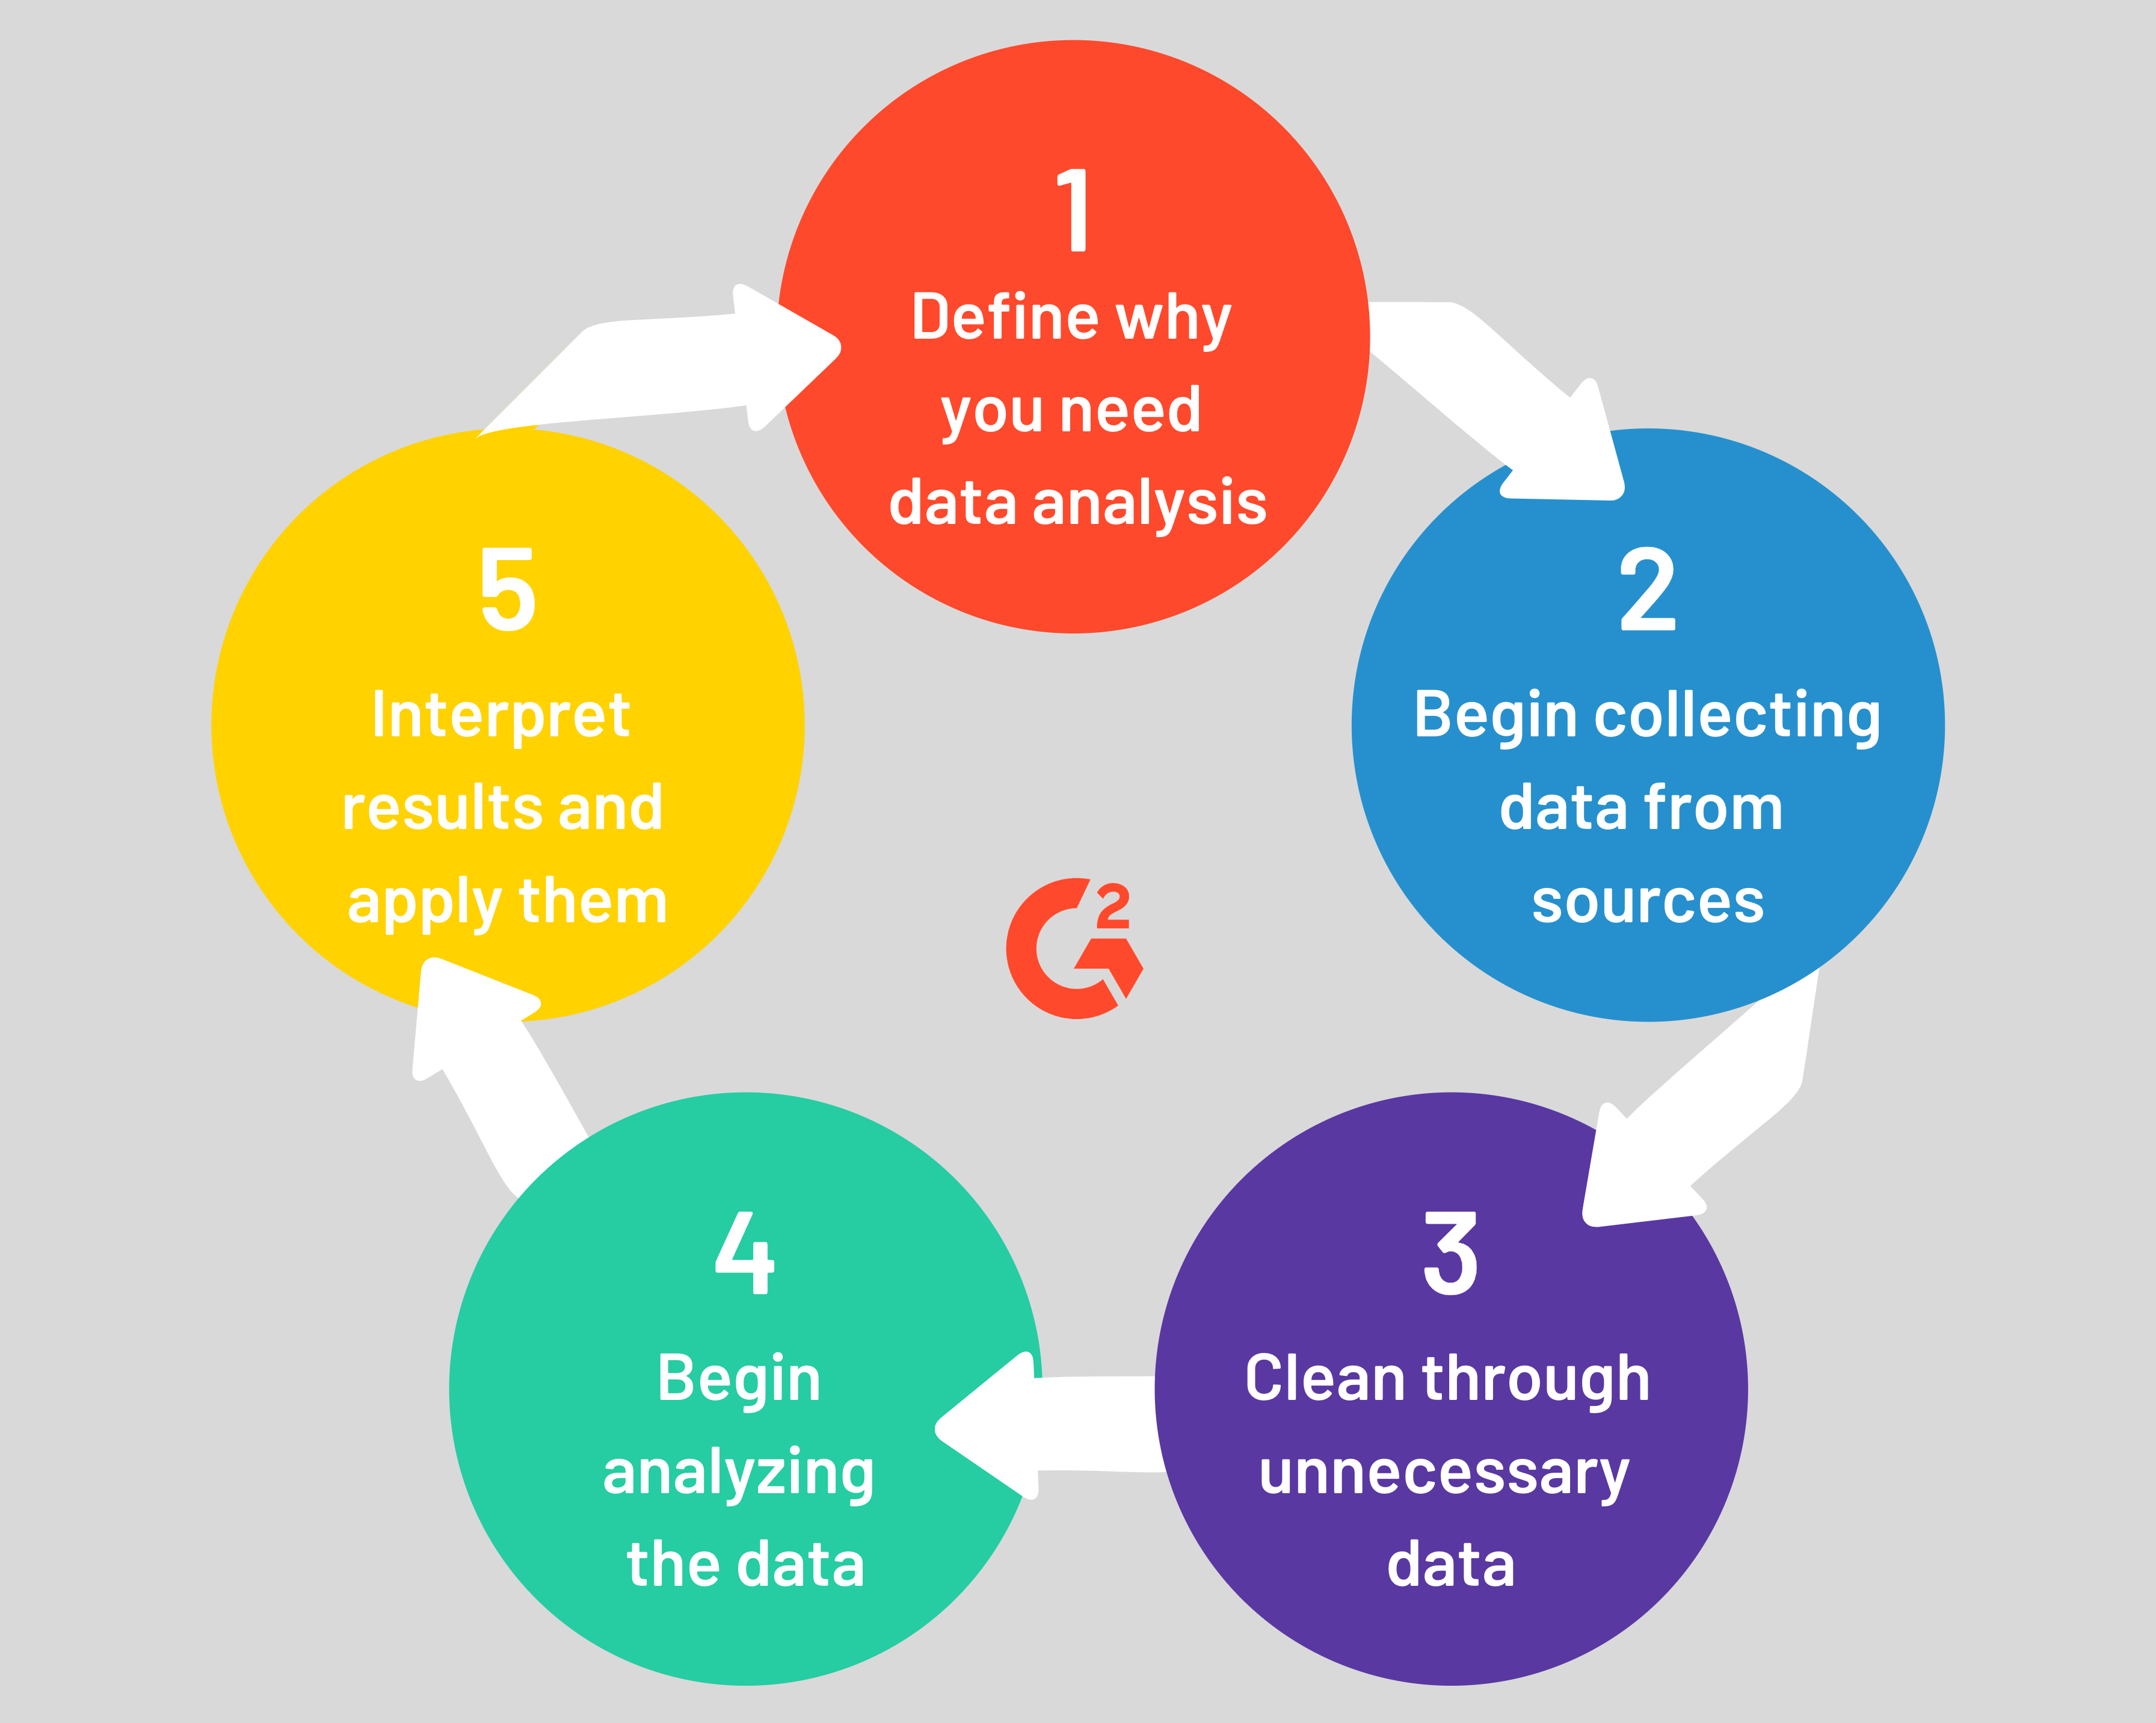
Various steps involved in Data Analytics

Slide 4
Responsibilities of a Data Analyst
The following is a list of some of the data analyst roles and responsibilities:
A data analyst oversees organizing data related to sales figures, market research, logistics, linguistics, or other behaviors. They use technical expertise to ensure that data is accurate and of high quality. Data is then analyzed, designed, and presented in a way that helps individuals, businesses, and organizations make better decisions.
Using automated technologies for data extraction from primary and secondary sources.
Eliminating damaged data, fixing coding difficulties, and other problems.
Creating and managing databases and data systems involves reorganizing data into a format that is readable.
Evaluating data to establish its value and quality.
Examine reports and performance metrics to spot and fix coding errors.
Using statistical tools to identify, analyze, and interpret patterns and trends in large data sets that could aid in diagnosis and prediction.
Assigning numerical values to essential business functions in order to assess and compare business performance over time.
Analyzing trends at the local, national, and global levels that affect both the organization and the industry.
Creating reports for management that include trends, patterns, and predictions based on relevant data.
Working with programmers, engineers, and management to identify process improvement opportunities, recommend system changes, and develop data governance strategies. This is one of the important roles of a data analyst.
Preparing final analysis reports to assist stakeholders in comprehending the data-analysis steps and making critical decisions based on various patterns and facts.
An important part of a data analyst’s job description is the exploratory data analysis project (EDA). The data analyst for these efforts must thoroughly review the data to identify trends. The next stage for data analysts is to implement data modelling techniques to encompass the key facets of data analysis.

Slide 5
Key skills required for a Data Analyst
Here are the eight most important data analyst skills:
Data cleaning and preparation
Data analysis and exploration
Statistical knowledge
Creating data visualizations
Creating dashboards and reports
Writing and communication
Domain knowledge
Problem solving

Slide 6
Common Problems that Data Analysts encounter during analysis
Lack of skilled resources with understanding of Big Data Analytics.
Gaining meaningful insights using Big Data Analytics.
Bringing extensive data to big data platform.
Uncertainty of Data Management Landscape.
Data Storage and fast retrieval.

Slide 7
Difference between Data Analytics and Data Science
Feature | Data Science | Data Analytics
Coding Language | Python is the most commonly used language for data science along with the use of other languages such as C++, Java, Perl, etc. | The Knowledge of Python and R Language is essential for Data Analytics.
Programming Skills | In- depth knowledge of programming is required for data science. | Basic Programming skills is necessary for data analytics.
Use of Machine Learning | Data Science makes use of machine learning algorithms to get insights. | Data Analytics doesn’t makes use of machine learning.
Other Skills | Data Science makes use of Data mining activities for getting meaningful insights. | Hadoop Based analysis is used for getting conclusions from raw data.
Scope | The scope of data science is large. | The Scope of data analysis is micro i.e., small.
Goals | Data science deals with explorations and new innovations. | Data Analysis makes use of existing resources.
Data Type | Data Science mostly deals with unstructured data. | Data Analytics deals with structured data.
Statistical Skills | The statistical skills are necessary in the field of Data Science.. | The statistical skills are of minimal or no use in data analytics.

